Slide 1
A Study Of The Book Of Revelation
July 18, 2021

Slide 2

Revelation 18:20
Revelation 18
cf. Revelation 6:9-11
“Rejoice over her, thou heaven, and ye saints, and ye apostles, and ye prophets; for God hath judged your judgment on her.”

Slide 3
Rejoicing of the Saints!
Revelation 18
The righteous can now rejoice!
Vindication has now been achieved!
Revelation 6:9-11; 11:17-18
Worldly weep but God’s servants rejoice!
Sinful persecutors have received a righteous judgment
Not a happiness over the loss of life and souls of men – but the victory of good over evil! Righteousness triumphs!
Note: Ezekiel 33:11; 2 Peter 3:9; 1 Timothy 2:4

Slide 4
Revelation 18:21
Revelation 18
Isaiah 13:17-22; 14:21-23;
Jeremiah 50-51
“And a strong angel took up a stone as it were a great millstone and cast it into the sea, saying, Thus with a mighty fall shall Babylon, the great city, be cast down, and shall be found no more at all.”

Slide 5
Character of Rome’s Fall
Revelation 18
Example of the mighty angel
Took up stone – like a great millstone – threw it into the sea
Millstone used for grinding meal
Makes a big splash and sinks very quickly!
Persecuting Rome of John’s day has ended!
Emperor worship and persecution of the God’s children – is no more!

Slide 6
Character of Rome’s Fall
Revelation 18
She lost the glory of a city that ruled the world
Never again to be restored to that lofty power state again – Jeremiah 51:63-64
Rebellious and arrogant Rome will never rise again!
Capital city no longer wallowing in luxury and spiritual adultery!

Slide 7
Revelation 18:22
Revelation 18
“And the voice of harpers and minstrels and flute-players and trumpeters shall be heard no more at all in thee; and no craftsman, of whatsoever craft, shall be found any more at all in thee; and the voice of a mill shall be heard no more at all in thee;”

Slide 8
Revelation 18:23
Revelation 18
“and the light of a lamp shall shine no more at all in thee; and the voice of the bridegroom and of the bride shall be heard no more at all in thee: for thy merchants were the princes of the earth; for with thy sorcery were all the nations deceived.”

Slide 9
Revelation 18:24
Revelation 18
Revelation 16:6; 17:6
“And in her was found the blood of prophets and of saints, and of all that have been slain upon the earth.”

Slide 10
Ancient Rome Dead Forever
Revelation 18
Life (not buildings) as known by the Roman citizen will cease to exist
Paganism backed by the empire fell with Rome!
“Life as usual” – never to be enjoyed again!
Wrath of God has been visited upon the city:
No voice of harpers and musicians
No pipers and trumpeters
No craftsmen
No sound of a millstone anymore (economic)

Slide 11
Rome
Revelation 18
Wrath of God has been visited upon the city:
No light of candle shines anymore
Voice of the bridegroom and bride no longer heard
Merchants were great on the earth
For by sorceries all the nations had been deceived!

Slide 12
Why?
Revelation 18
Wrath of God has been visited upon the city: Revelation 14:1, 7; 14:9-12, 19; 16:1; 19:11-16
Blood of the prophets
Blood of the saints
All the slain upon the earth
Shall reap of her sins against the church!
Figurative way the “blood of all” was on her hands.
In the first appearance of “the beast” in Revelation, he was portrayed as the power that militated against God’s two witnesses who prophesied.
He would “war against them and shall overcome them, and kill them” (11:7-8; 17:6; 18:20).

Slide 13
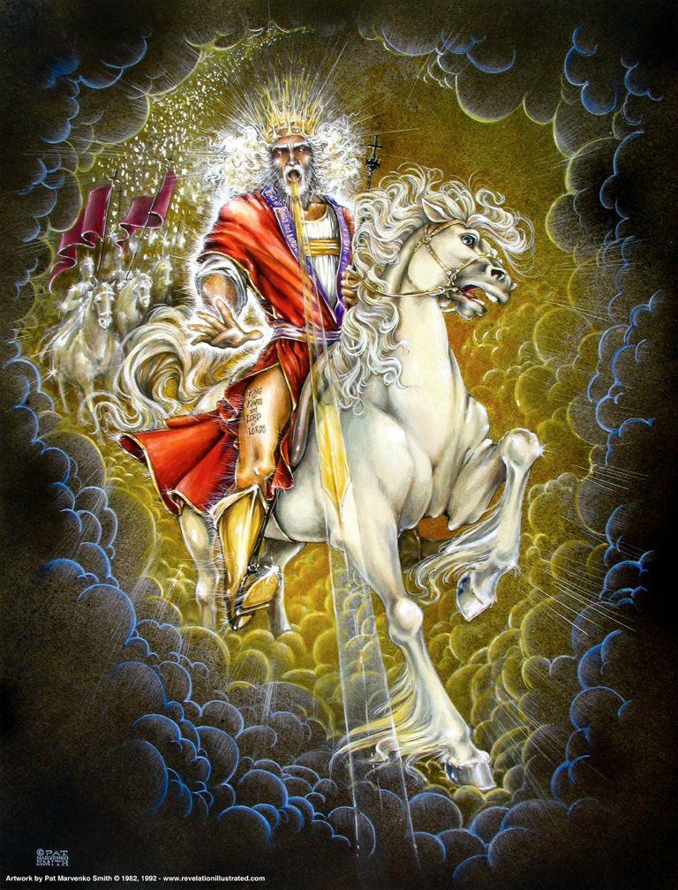
Book of Revelation: Chapter 19
Righteous Judgment of God Praised
The Victorious Christ

Slide 14
Resources used:
A Study Of The Book Of Revelation by Bob Dodson
More Than Conquerors by William Hendriksen
Overcoming With The Lamb, Florida College Annual Lectures, February 7-10, 1994
Outline of the Book of Revelation by John Robertson – Floral Heights Church of Christ https://floralheightschurchofchrist.org/Class%20-%20Bible%20Books/Revelation.pdf
Revelation – An Introduction and Commentary by Homer Hailey
Revelation (Truth Commentaries) by Robert Harkrider
Revelation (A Study Workbook) by Robert Harkrider
Revelation and charts by Donnie Rader
Revelation charts by Keith Greer
Studies In The Book Of Revelation by Ferrell Jenkins
The Apocalypse of St. John by Henry Barclay Swete http://biblicalstudies.gospelstudies.org.uk/pdf/e-books/swete_h-b/apocalypse-of-st-john_swete.pdf (540 pages)
The Old Testament In The Book Of Revelation by Ferrell Jenkins
The Revelation Of St. John The Divine by G.B. Caird
The Book of Revelation by Foy E. Wallace
The Avenging of the Apostles and Prophets by Arthur M. Ogden
Worthy Is The Lamb by Ray Summers
Written exchange on THE DOMITIAN PERSECUTION between Arthur M. Ogden and Ferrell Jenkins presented in Searching The Scriptures, June 12, 1989, pages 7-12

Slide 15
Rejoicing of the Saints
Revelation 19
Chapter 18 revealed the destruction of the harlot city Rome and the world’s reaction of sorrow due to a loss of luxurious living and social status.
In contrast with the mourning of the kings, merchants, and those who made their living on the sea, were the saints of God. The saints were told to rejoice at the tyrant’s fall (Revelation 18:20).
Chapter 19 expounds upon this rejoicing and reveals the destruction of the beast and the false prophet.
While those who drank Rome’s wine and were intoxicated with her lust, wealth, and worldly status believed she was indestructible the Lord proved her weak and feeble.
Her ways that seemed so appealing and entertaining have now been proved poisonous and deadly.
The saints who abstained from fellowship with her sins have cause for rejoicing because they were right to reject her pernicious ways (see Revelation 18:4).

Slide 16
Revelation 19:1
Revelation 19
“After these things I heard as it were a great voice of a great multitude in heaven, saying, Hallelujah; Salvation, and glory, and power, belong to our God”

Slide 17
Revelation 19:2
Revelation 19
“for true and righteous are his judgments; for he hath judged the great harlot, her that corrupted the earth with her fornication, and he hath avenged the blood of his servants at her hand.”

Slide 18
Rejoicing of the Saints
Revelation 19
Emperors’ worshippers judged (14:9-12) (cf. Revelation 17:5; 18:20-21).
First “Hallelujah” (“Praise to the Lord”)
“Loud voice of a great multitude” (Sounded like)
Alleluia – “salvation, glory, honor and power belong to the Lord our God”
World mourns – God’s people rejoice!

Slide 19
Rejoicing of the Saints
Revelation 19
“Nowhere else is this word found in the New Testament; however, commencing with Psalm 104, many of the psalms begin and/or end with ‘praise ye the Lord.’ This scene of exultation should not have been separated from the last chapter, for it reveals a sharp contrast with the kings, merchants, and shipmen who mourn over the downfall of the harlot. John hears praise of God coming from heaven four times (19:1, 3, 4, 6).” (Robert Harkrider, Revelation, Truth Commentaries, page 277)

Slide 20
Rejoicing of the Saints
Revelation 19
God’s judgments are true and righteous
He judged the great harlot that had corrupted the earth with her fornication
He has avenged the blood of His servants
Vindication has now been achieved!
Triumph of righteousness over evil
Calm certainty knowing God can conquer and judge His enemies

Slide 21
Rejoicing of the Saints
Revelation 19
Condemnation of the Beast and Worshippers
God’s judgments are true and righteous
He judged the great harlot that had corrupted the earth with her fornication
He has avenged the blood of His servants
Vindication has now been achieved!
Triumph of righteousness over evil
Their future in the spiritual realm is eternal life
Their smoke rising up for ever and ever, eternal punishment (14:9-11; 20:10; Matthew 25:46).

